Slide 1
Gage R&R Companion
ChemE 546 Final Project
Mason Keller, Henry Nguyen, Logan Sayyadi

Slide 2
Background & Motivation
Background:
Every process has some degree of variability. Knowing the uncertainty associated with a given process informs decision making, and fuels continuous process improvement.
Repeatability - Variability as a result of the instrument/process
Reproducibility - User-to-user variability
If you are in a production space both will play significant roles in the quality of your final product
Motivation:
Large companies frequently employ Gage R&R, a type of experiment designed to characterize the repeatability and reproducibility of a process or instrument
Heavily reliant on the software Minitab to design experiment and analyze data
Minitab costs up to $3000 / year per person, and is typically out of the question for small companies

Slide 3
Overview/Decision making
Objective:
Design open-source software that can assist with the design of Gage R&R experiments, and analyze the data for tangible next steps. We want our software to be reliable and easy to use, while still being able to do detailed analysis.
Major Dependencies:
Pandas and numpy used for backend calculations.
Reliable and well documented
Streamlit used for the GUI.
Easy to code, less likely to have mistakes.
Well documented - LLMs have more examples to help code with.
Compatible with existing pipeline
Altair used for plots.
Easy to code
Aesthetic, interactable plots.

Slide 4
Workflow - Front End
Utilizes Streamlit as the primary GUI for interaction
Starts on landing page that leads to either analysis or documentation
Charts and metrics can be seen in analysis
General info and guides can be seen in documentation
Analysis
View Control Charts
Upload CSV
View Metrics and Interpretation
Landing Page
How to get started
Documentation

Slide 5
Workflow - Back End
Used same algorithms as Minitab for variant component calculation
Data validation, ANOVA, variance components, and summary table computed sequentially
Outputs graded against industry standard thresholds (<10%=Acceptable, 10-30%=Marginal, >30%=Unacceptable)
Control Charts
Bar Charts
Operator Box Charts
.csv file
Data Processing
Statistics
ANOVA Table
Outputs: % Reproducibility, % repeatability, %Part-to-Part and Classification.

Slide 6
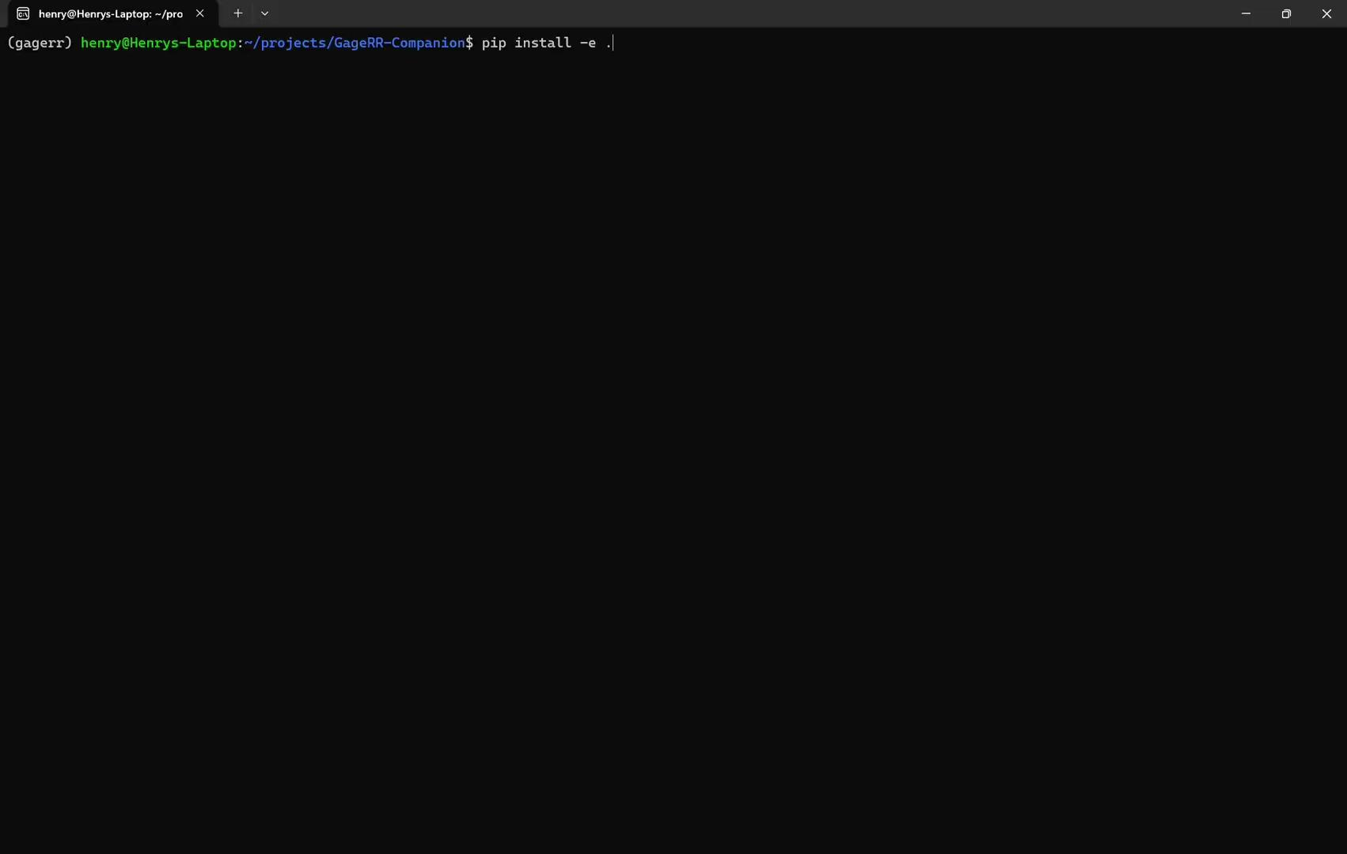
Demo

Slide 7
Next Steps (Focus for 547)
Update app to accommodate different types of Gage testing, all of which utilize our existing pipeline:
Crossed (Done!)
Nested
Expanded
Type 1
Assisting with Gage design of experiment
Using decision tree style flowchart to guide user to the correct type of Gage test
Potentially using an LLM agent to assist with experimental design: number of operators, number of replicates, etc.
Additional improvements
Recommended follow-up actions
GUI refinements

